Slide 1


Slide 2

PROJECT OVERVIEW

Slide 3

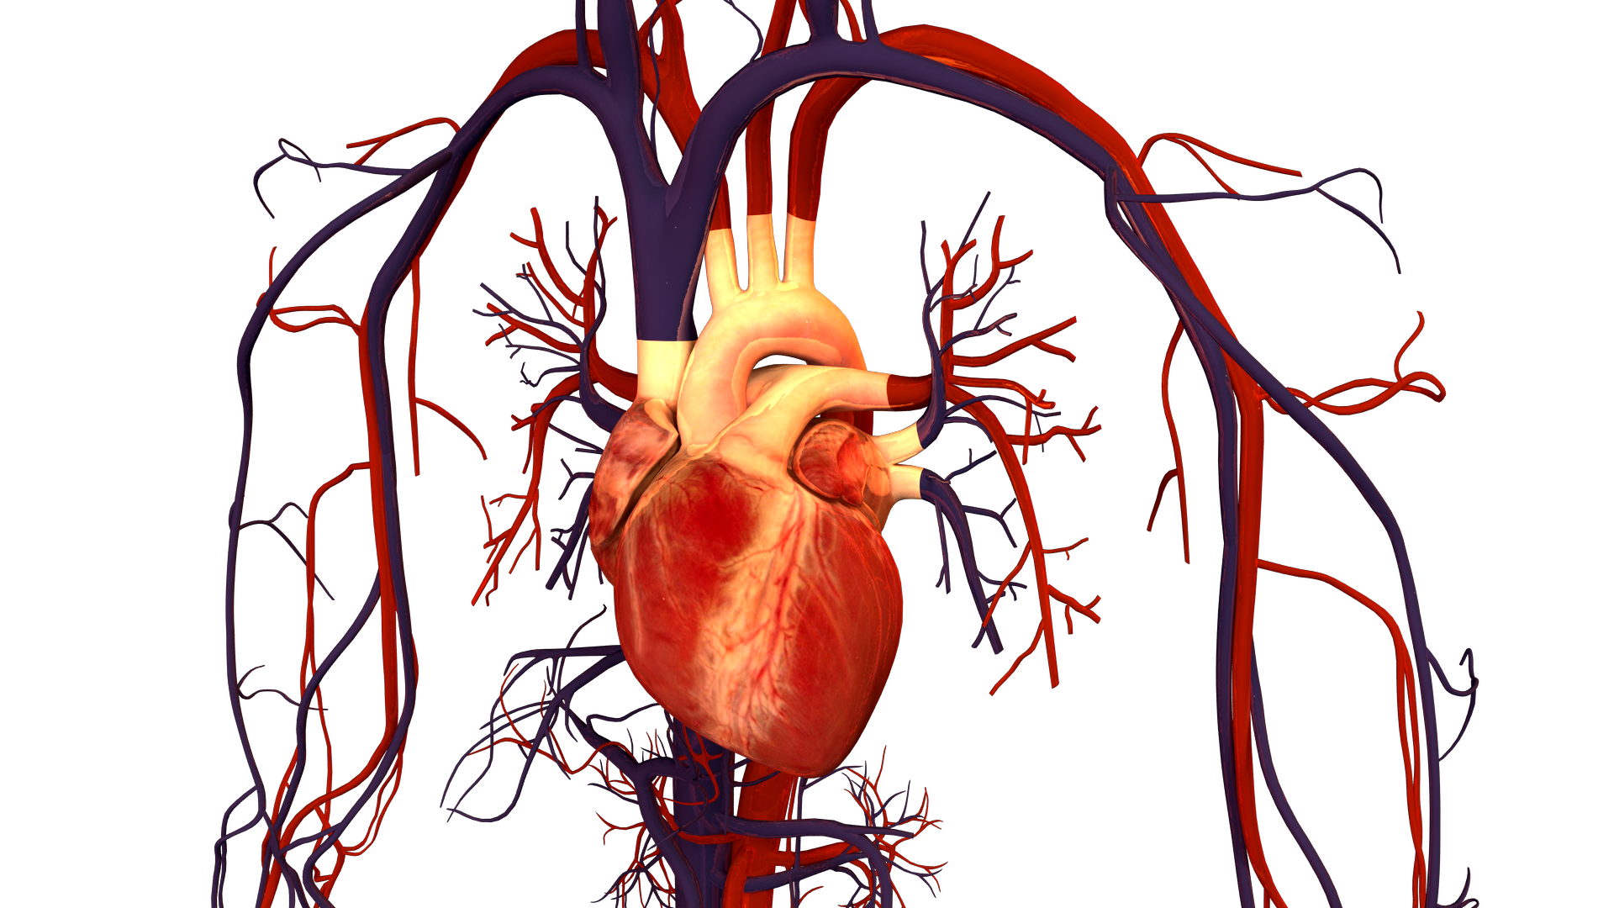
PROJECT OVERVIEW:
Aim of the problem is to detect the presence or absence of cardiovascular disease in person based on the given features.
Features available are:
Age
Height
Weight
Gender
Smoking
Alcohol intake
Physical activity
Systolic blood pressure
Diastolic blood pressure
Cholesterol
Glucose
Data Source: https://www.kaggle.com/sulianova/cardiovascular-disease-dataset
Image Source: https://commons.wikimedia.org/wiki/File:Human_Heart_and_Circulatory_System.png

Slide 4
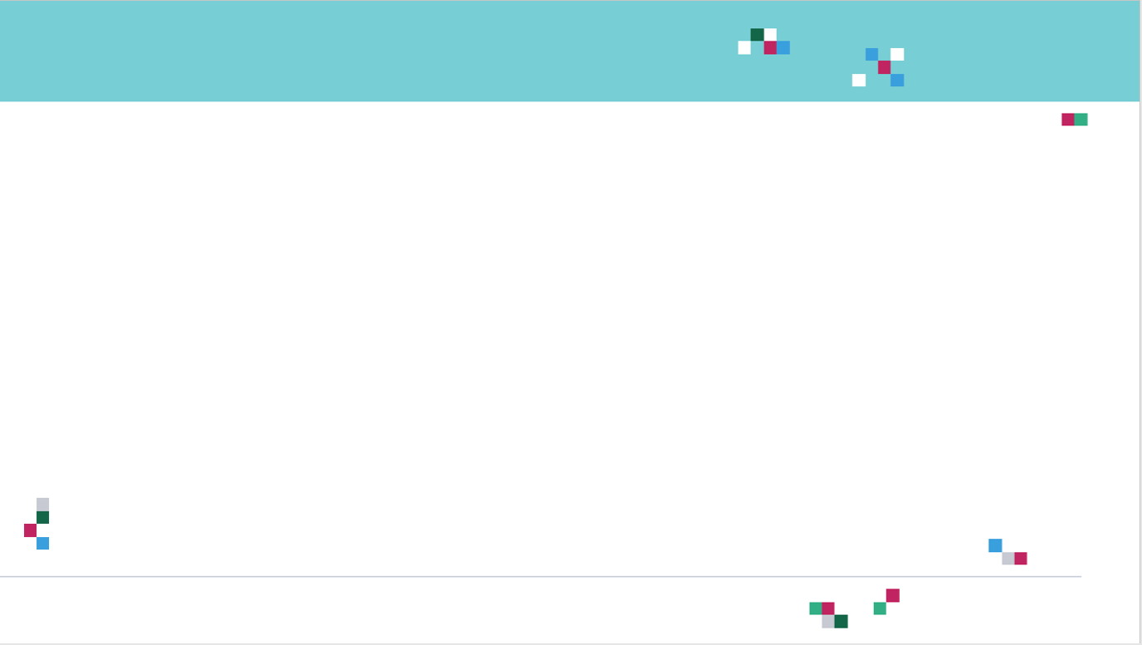
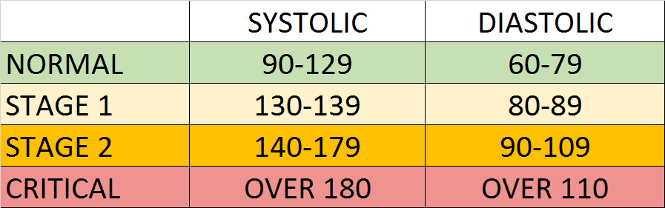
PROJECT OVERVIEW: NOTES ON BLOOD PRESSURE
Blood Pressure notes:
Blood pressure is represented by 2 numbers systolic and diastolic (ideally 120/80 mm Hg).
These two number are critical in assessing the heart health.
The top number represents systolic and the bottom number representing the diastolic.
Systolic pressure indicates the blood pressure in the arteries when the blood is pumped out of the heart.
The diastolic pressure indicates the blood pressure between beats (at rest, filling up and ready to pump again).
If these numbers are high, that means that the heart is exerting more effort to pump blood in the arteries to the body.
Photo Source: https://commons.wikimedia.org/wiki/File:Hypertension_ranges_chart.png

Slide 5
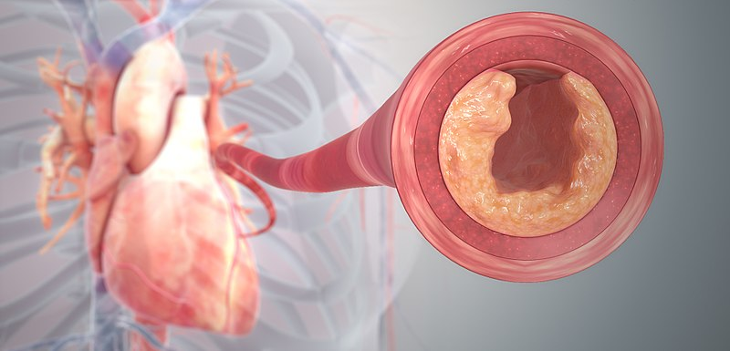
PROJECT OVERVIEW: NOTES ON CHOLESTEROL
Cholesterol notes:
Cholesterol is a waxy material found in humans blood.
Normal level of cholesterol is necessary to ensure healthy body cells but as these levels increase, heart disease risk is elevated.
This waxy material can block the arteries and could result in strokes and heart attacks.
Healthy lifestyle and regular exercises can reduce the risk of having high cholesterol levels.
More information: https://www.mayoclinic.org/diseases-conditions/high-blood-cholesterol/symptoms-causes/syc-20350800
Photo Credit: https://commons.wikimedia.org/wiki/File:Clogged_Heart_Artery.jpg

Slide 6
PROJECT OVERVIEW: NOTES ON GLUCOSE
Glucose notes:
Glucose represents the sugar that the human body receive when they consume food.
Glucose means “sweet” in Greek.
Insulin hormone plays a key role in moving glucose from the blood to the body cells for energy.
Diabetic patients have high glucose in their blood stream which could be due to two reasons:
They don’t have enough insulin
Body cells do not react to insulin the proper way
Read more: https://www.webmd.com/diabetes/glucose-diabetes
Photo Credit: https://commons.wikimedia.org/wiki/File:Clogged_Heart_Artery.jpg

Slide 7
PRINCIPAL COMPONENT ANALYSIS (PCA)

Slide 8
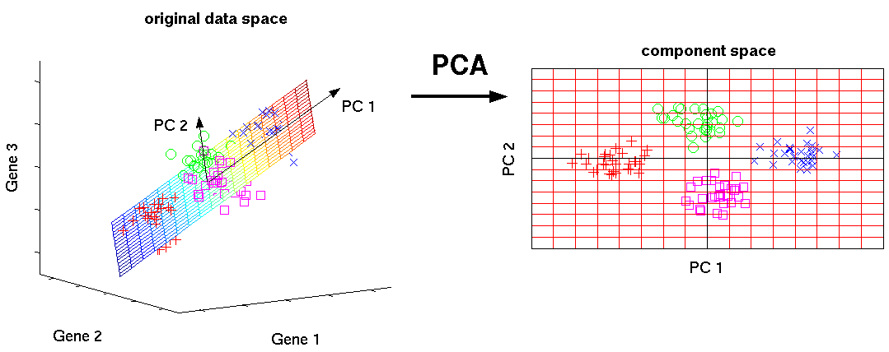
PRINCIPAL COMPONENT ANALYSIS: OVERVIEW
PCA is an unsupervised machine learning algorithm that performs dimensionality reductions while attempting at keeping the original information unchanged.
PCA works by trying to find a new set of features called components.
Components are composites of the uncorrelated given input features.
In Amazon SageMaker PCA operates in two modes:
Regular: works well with sparse data small (manageable) number of observations/features.
Randomized: works well with large number of observations/features.
Photo Credit: http://phdthesis-bioinformatics-maxplanckinstitute-molecularplantphys.matthias-scholz.de/

Slide 9

PRINCIPAL COMPONENT ANALYSIS: HYPERPARAMETERS
Full set of hyperparameters: https://docs.aws.amazon.com/sagemaker/latest/dg/PCA-reference.html
feature_dim: number of features in the input data.
num_components: number of principal components to compute.
algorithm_mode: Mode for computing the principal components, choose between regular or randomized
extra_components: As extra components go up, more accurate results are achieved at the cost of increased memory/computation consumption.

Slide 10
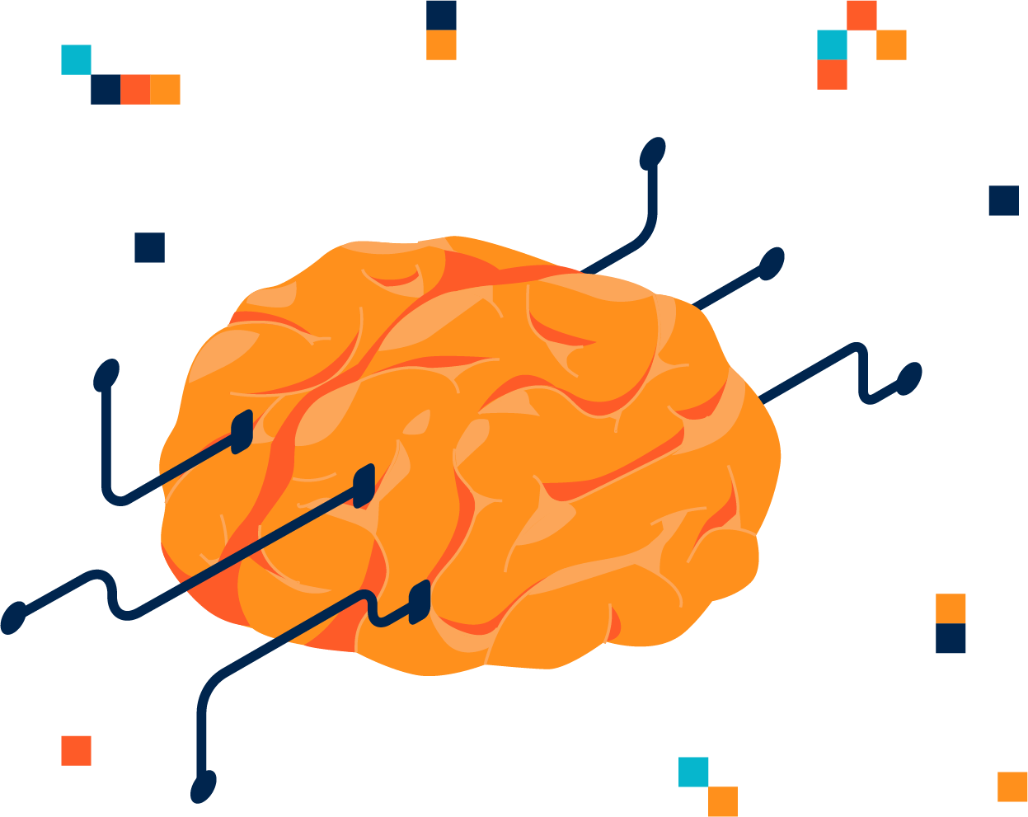
PRINCIPAL COMPONENT ANALYSIS: INPUT/OUTPUT
SageMaker PCA algorithm supports recordIO-protobuf or CSV formats
PCA can be used in both File or pipe mode
Remember if pipe mode is activated, training data can be directly streamed into the training instance instead of being downloaded from S3.
Pipe model can speed up the process and require less disk space.
For more information on pipe mode, check this out: https://aws.amazon.com/blogs/machine-learning/using-pipe-input-mode-for-amazon-sagemaker-algorithms/

Slide 11

PRINCIPAL COMPONENT ANALYSIS: INSTANCE TYPES
For PCA Training:
CPU instance or GPU are recommended

Slide 12
XGBOOST (CLASSIFICATION)

Slide 13
SAGEMAKER XGBOOST: OVERVIEW
XGBoost or Extreme Gradient Boosting algorithm is one of the most famous and powerful algorithms to perform both regression and classification tasks.
XGBoost is a supervised learning algorithm and implements gradient boosted trees algorithm.
The algorithm work by combining an ensemble of predictions from several weak models.
Note that Xgboost could be used for both regression and classification (our case study).
TREE #1
TREE #2
TREE #N
Savings>$1M
Savings>$1M
Savings>$1M
Yes
No
Yes
No
Yes
No
Age > 45?
Class #0
Age > 45?
Class #0
Age > 45?
Class #0
Yes
No
Yes
No
Yes
No
Class #1
Class #0
Class #1
Class #0
Class #1
Class #0
OUT = CLASS #1
OUT = CLASS #1
OUT = CLASS #0
MAJORITY VOTE = CLASS #1

Slide 14
SAGEMAKER XGBOOST: OVERVIEW
Recently, XGBoost is the go to algorithm for most developers and has won several Kaggle competitions.
Why does Xgboost work really well?
Since the technique is an ensemble algorithm, it is very robust and could work well with several data types and complex distributions.
Xgboost has a many tunable hyperparameters that could improve model fitting.
What are the applications of XGBoost?
XGBoost could be used for fraud detection to detect the probability of a fraudulent transactions based on transaction features.

Slide 15
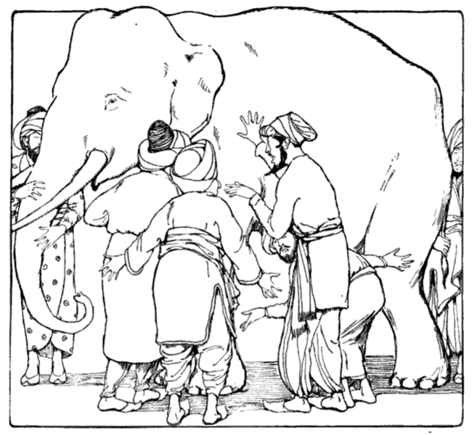
REMEMBER THAT XGBOOST IS AN EXAMPLE OF ENSEMBLE LEARNING
Ensemble techniques such as bagging and boosting can offer an extremely powerful algorithm by combining a group of relatively weak/average ones.
For example, you can combine several decision trees to create a powerful random forest algorithm
By Combining votes from a pool of experts, each will bring their own experience and background to solve the problem resulting in a better outcome.
Bagging and Boosting can reduce variance and overfitting and increase the model robustness.
Example: Blind men and the elephant!
Model #1
Model #2
Model #3
VOTING
Photo Credit: https://commons.wikimedia.org/wiki/File:Blind_men_and_elephant.png

Slide 16
MODEL PERFORMANCE ASSESSMENT – CONFUSION MATRIX

Slide 17
CONFUSION MATRIX
TRUE CLASS
+
-
TYPE I ERROR
+
TRUE +
FALSE +
PREDICTIONS
FALSE -
TRUE -
-
TYPE II ERROR

Slide 18
CONFUSION MATRIX
A confusion matrix is used to describe the performance of a classiﬁcation model:
True positives (TP): cases when classiﬁer predicted TRUE (they have the disease), and correct class was TRUE (patient has disease).
True negatives (TN): cases when model predicted FALSE (no disease), and correct class was FALSE (patient do not have disease).
False positives (FP) (Type I error): classiﬁer predicted TRUE, but correct class was FALSE (patient did not have disease).
False negatives (FN) (Type II error): classiﬁer predicted FALSE (patient do not have disease), but they actually do have the disease

Slide 19
KEY PERFORMANCE INDICATORS (KPI)
Classiﬁcation Accuracy = (TP+TN) / (TP + TN + FP + FN)
Misclassiﬁcation rate (Error Rate) = (FP + FN) / (TP + TN + FP + FN)
Precision = TP/Total TRUE Predictions = TP/ (TP+FP) (When model predicted TRUE class, how often was it right?)
Recall = TP/ Actual TRUE = TP/ (TP+FN) (when the class was actually TRUE, how often did the classiﬁer get it right?)

Slide 20
MODEL PERFORMANCE ASSESSMENT – PRECISION, RECALL AND F1-SCORE

Slide 21
PRECISION Vs. RECALL EXAMPLE
TRUE CLASS
FACTS:
100 PATIENTS TOTAL
91 PATIENTS ARE HEALTHY
9 PATIENTS HAVE CANCER
+
-
TP = 1
FP = 1
Accuracy is generally misleading and is not enough to assess the performance of a classifier.
Recall is an important KPI in situations where:
Dataset is highly imbalanced; cases when you have small cancer patients compared to healthy ones.
+
PREDICTIONS
-
FN = 8
TN = 90
Classiﬁcation Accuracy = (TP+TN) / (TP + TN + FP + FN) = 91%
Precision = TP/Total TRUE Predictions = TP/ (TP+FP) = ½=50%
Recall = TP/ Actual TRUE = TP/ (TP+FN) = 1/9 = 11%

Slide 22
PRECISION DEEP DIVE
TRUE CLASS
$$Precision =\frac{TRUE POSITIVES}{TOTAL TRUE PREDICTIONS}$$
$$Precision =\frac{TRUE POSITIVES}{TRUE POSITIVES+FALSE POSITIVES}$$
$$Precision =\frac{1}{1+1}=50\%$$
+
-
TP = 1
FP = 1
+
PREDICTIONS
-
FN = 8
TN = 90
NOTES:
Precision is a measure of Correct Positives, in this example, the model predicted two patients were positive classes (has cancer), only one of the two was correct.
Precision is an important metric when False positives are important (how many times a model says a pedestrian was detected and there was nothing there!
Examples include drug testing

Slide 23
RECALL DEEP DIVE
$$Recall =\frac{TRUE POSITIVES}{ACTUAL TRUE }$$
$$Recall =\frac{TRUE POSITIVES}{TRUE POSITIVES+FALSE NEGATIVES}$$
$$Recall =\frac{1}{1+8}=11\%$$
TRUE CLASS
+
-
TP = 1
FP = 1
+
PREDICTIONS
-
FN = 8
TN = 90
NOTES:
Recall is also called True Positive rate or sensitivity
In this example, I had 9 cancer patients but the model only detected 1 of them
Important metric when we care about false negatives
Example: Self driving cars and fraud detection

Slide 24
EX1: BANK FRAUD DETECTION
TRUE CLASS
+
-
THERE WAS FRAUD AND MODEL PREDICTED FRAUD
THERE WAS NO FRAUD AND MODEL PREDICTED FRAUD
PREDICTIONS
+
“This is the only case the bank loses money so bank cares about recall”
THERE WAS FRAUD AND MODEL PREDICTED NO FRAUD
THERE WAS NO FRAUD AND MODEL PREDICTED NO FRAUD
PISSED OFF CUSTOMER BUT THE BANK IS OK!
-
BANK LOSES MONEY

Slide 25
EX2: SPAM EMAIL DETECTION
TRUE CLASS
+
-
THERE WAS SPAM EMAIL AND MODEL PREDICTED SPAM (BLOCKED IT)
THERE WAS NO SPAM EMAIL AND MODEL PREDICTED SPAM (BLOCKED IT)
PREDICTIONS
+
“This is a case when we care about precision and it’s OK if we mess up recall a little bit”
THERE WAS A SPAM EMAIL AND MODEL PREDICTED NO SPAM (WENT TO INBOX)
BLOCKED IMPORTANT EMAILS (DREAM JOB!)
THERE WAS NO SPAM EMAIL AND MODEL PREDICTED NO SPAM (WENT TO INBOX)
-
NOT A BIG DEAL!

Slide 26
F1 SCORE
$$F1 Score =\frac{2 ∗(PRECISION ∗RECALL)}{(PRECISION+RECALL)}$$
$$F1 Score =\frac{2 ∗TP}{2∗TP+FP+FN}$$
F1 Score is an overall measure of a model's accuracy that combines precision and recall.
F1 score is the harmonic mean of precision and recall.
What is the difference between F1 Score and Accuracy?
In unbalanced datasets, if we have large number of true negatives (healthy patients), accuracy could be misleading. Therefore, F1 score might be a better KPI to use since it provides a balance between recall and precision in the presence of unbalanced datasets.

Slide 27
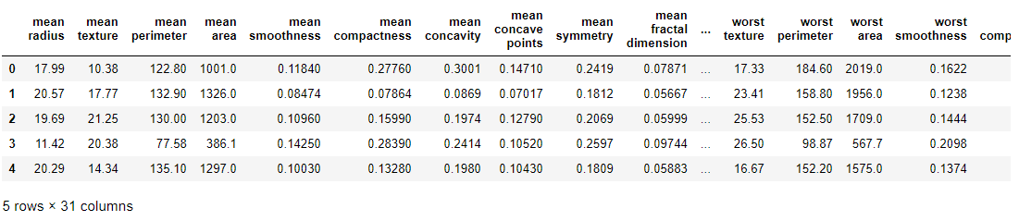
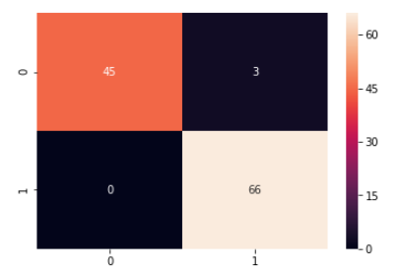
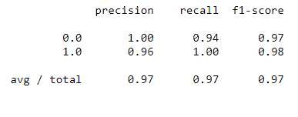
F1-SCORE PER CLASS: CANCER CLASSIFICATION DATASET
F1-SCORE PER CLASS
AVERAGE F1-SCORE

Slide 28
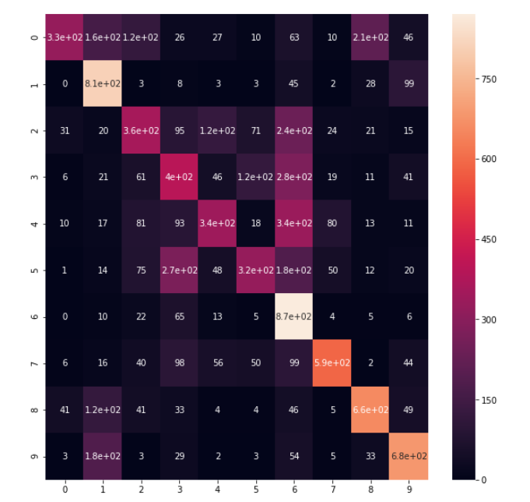
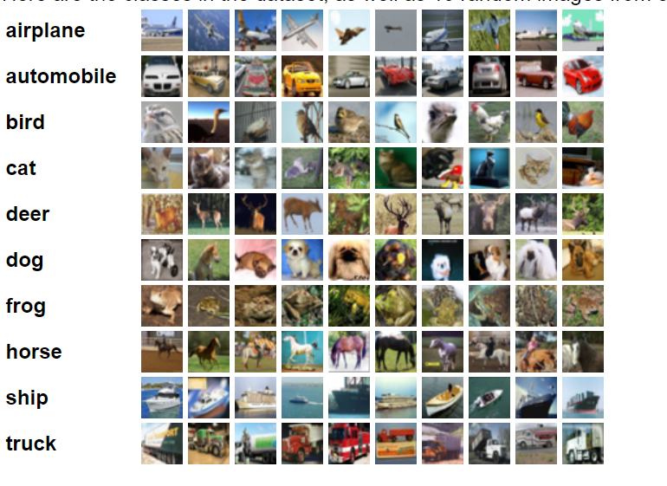
MULTICLASS CLASSIFICATION
https://www.cs.toronto.edu/~kriz/cifar.html

Slide 29
MODEL PERFORMANCE ASSESSMENT – ROC, AUC

Slide 30
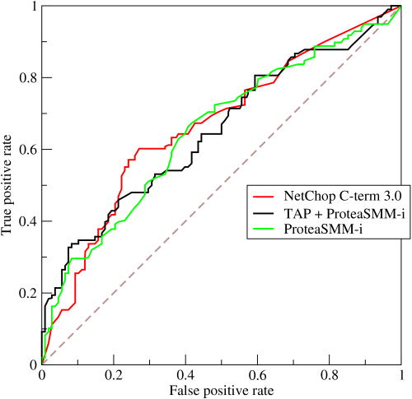
ROC (RECEIVER OPERATING CHARACTERISTIC CURVE)
ROC Curve is a metric that assesses the model ability to distinguish between binary (0 or 1) classes.
The ROC curve is created by plotting the true positive rate (TPR) against the false positive rate (FPR) at various threshold settings.
The true-positive rate is also known as sensitivity, recall or probability of detection in machine learning.
The false-positive rate is also known as the probability of false alarm and can be calculated as (1 − specificity).
Points above the diagonal line represent good classification (better than random)
The model performance improves if it becomes skewed towards the upper left corner.
Photo Credit: https://commons.wikimedia.org/wiki/File:Roccurves.png

Slide 31
AUC (AREA UNDER CURVE)
PREDICTOR #1
The light blue area represents the area Under the Curve of the Receiver Operating Characteristic (AUROC).
The diagonal dashed red line represents the ROC curve of a random predictor with AUROC of 0.5.
If ROC AUC = 1, perfect classifier
Predictor #1 is better than predictor #2
Higher the AUC, the better the model is at predicting 0s as 0s and 1s as 1s.
PREDICTOR #2
TRUE POSITIVE RATE
RANDOM PREDICTOR
FALSE POSITIVE RATE

Slide 32
OVERFITTING Vs. UNDERFITTING MODELS

Slide 33
UNDERFITTING MODEL
Model is under fitting if it’s too simple that it cannot reflect the complexity of the training dataset.
We can overcome under fitting by:
increasing the complexity of the model.
Training the model for a longer period of time (more epochs) to reduce error
MODEL IS TOO SIMPLE FOR THIS COMPLEX DATASET
X2
X1

Slide 34
OVERFITTING MODEL
Model is overfitting data when it memorizes all the specific details of the training data and fails to generalize.
Overfitting models tend to perform very well on the training dataset but poorly on any new dataset (testing dataset)
Machine learning is the art of creating models that are able to generalize and avoid memorization.
MODEL IS OVERFITTING THE DATA
X2
X1

Slide 35
BEST MODEL (GENERALIZED)
Model that performs well during training and testing (on new dataset that has never seen before) is considered the best model (goal).
GENERALIZED MODEL
X2
X1

